Slide 1
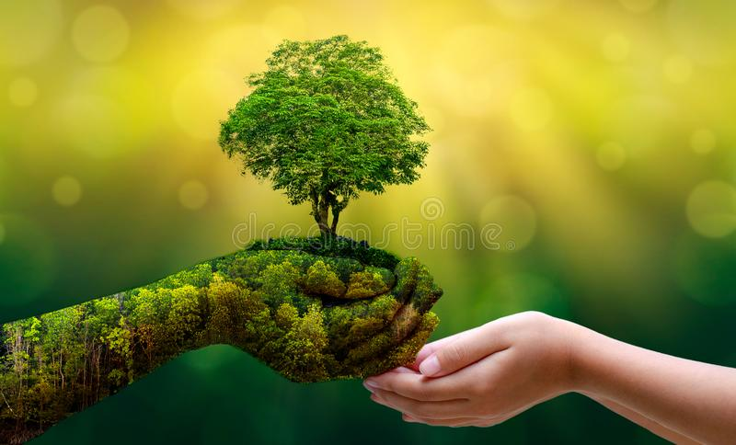
Introduction to Environmental Studies
Kishan Kumar Rai
Gandhi Institute of Technology

Slide 2
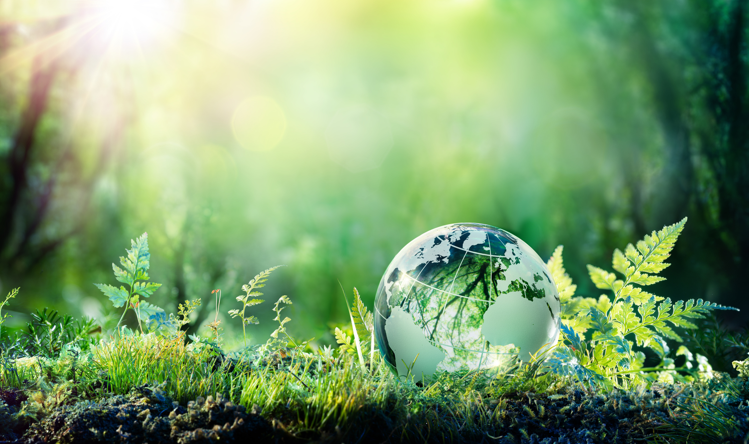
What do these terms mean?
Environment:-
Used in sentence : We need to protect the Earth’s Environment for the next generation.
Definition : The natural world and all the living and non-living things occurring and interacting on the Earth.
Study:-
Conservation and protection of natural resources.
Environmental education and communication.
Environmental research.

Slide 3
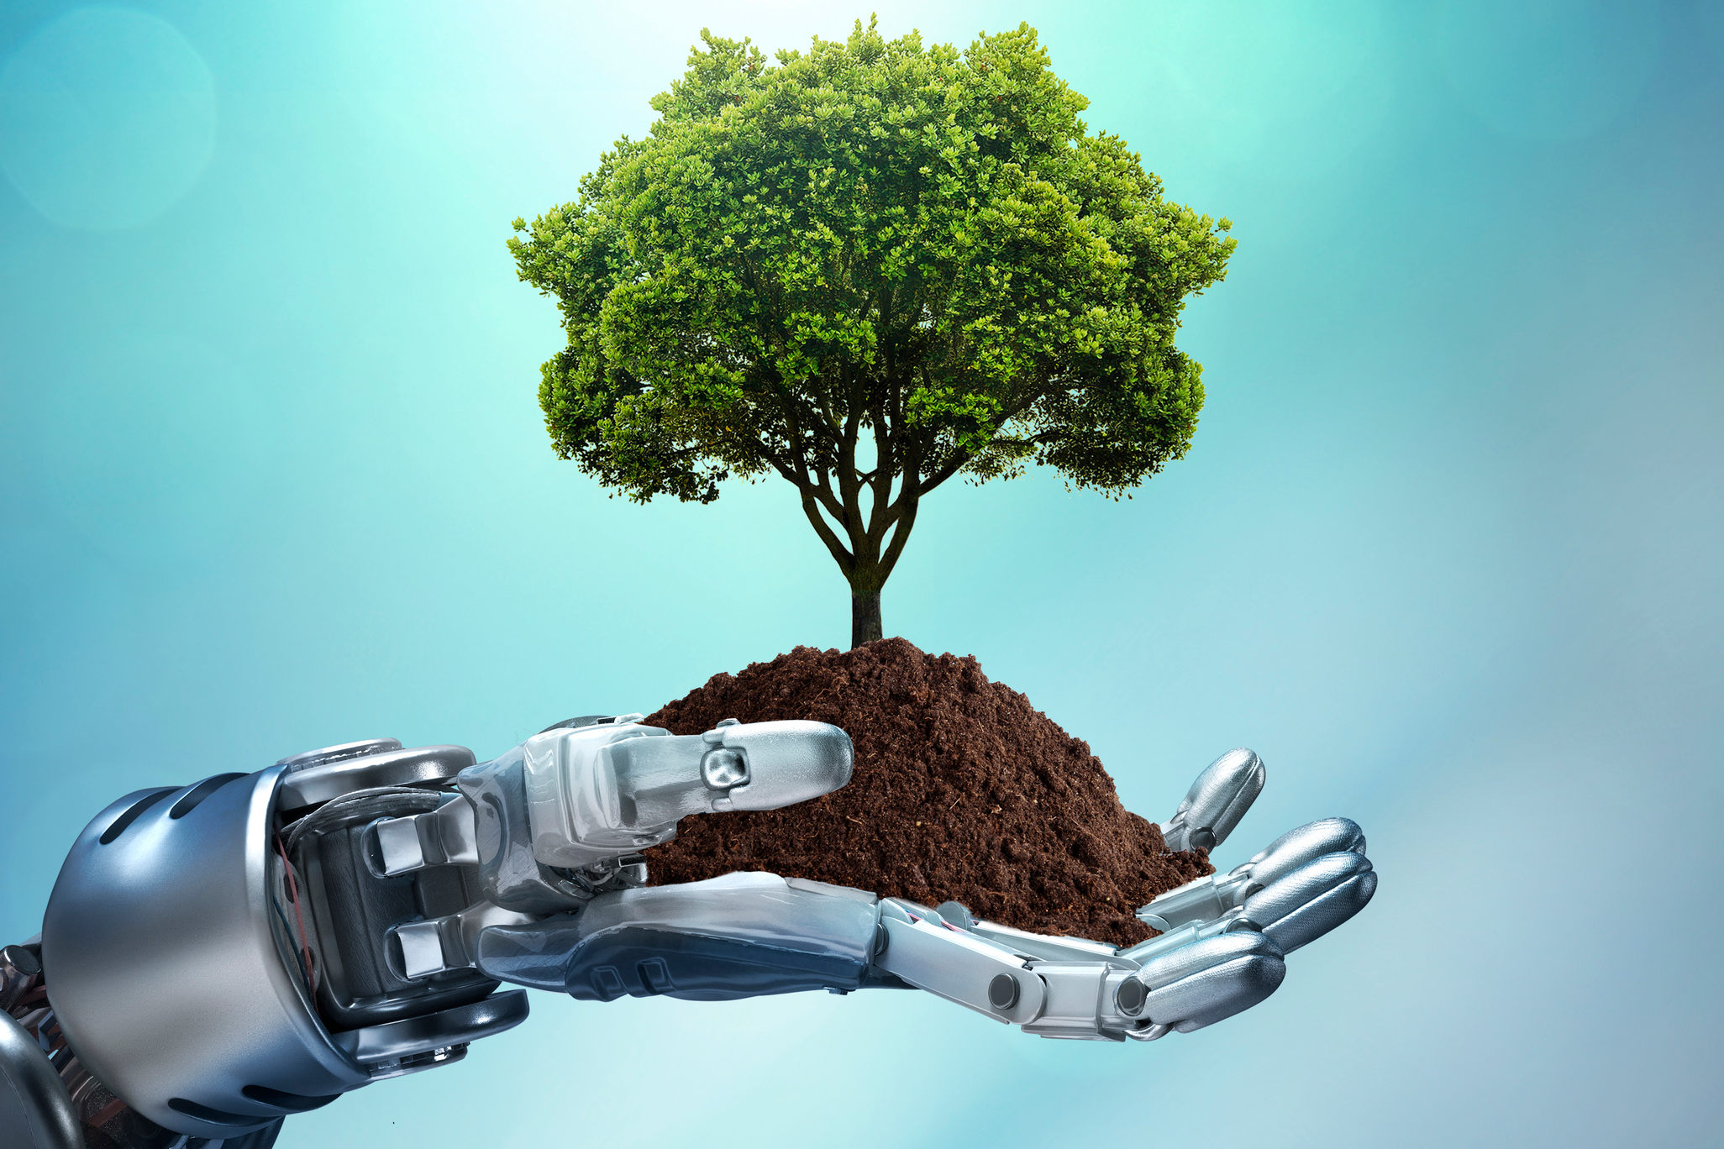
Scope of Environmental Science:-
Natural Resources
Ecology
Biodiversity and its conservation
Environment pollution and control
Natural disaster
Development
Social issues in relation to development and environment
Human population and environment

Slide 4
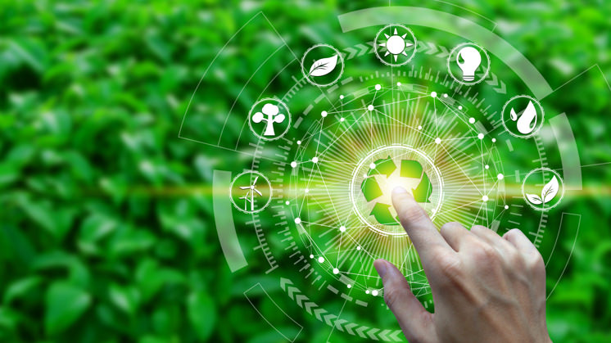
Elements of Environment
Physical elements
Physical elements are as space, landforms, water bodies, climate soils, rocks and minerals
They determine the variable character of the human habitat, its opportunities as well as Limitations
Biological elements
Biological elements such as plants, animals, microorganisms and men constitute
Biosphere
Cultural elements
Cultural elements such as economic, social and political elements are essentially manmade features

Slide 5
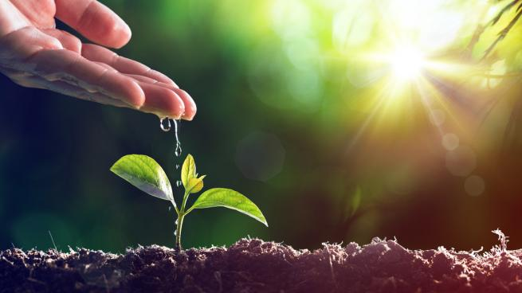
Importance of Environmental Studies:-
Environmental issues are being of Global
Development and Environment
Explosive increase in population
Problems cropped in the Wake of Development
Need to save Humanity from Extinction
Need for Wise Planning of Development

Slide 6
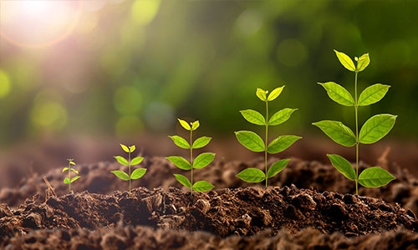
Types of Environments
According to Kurt Lewin, environment is of three types which influence the personality of an individual as under:
Physical Environment
Social and Cultural Environment
Psychological Environment.

Slide 7
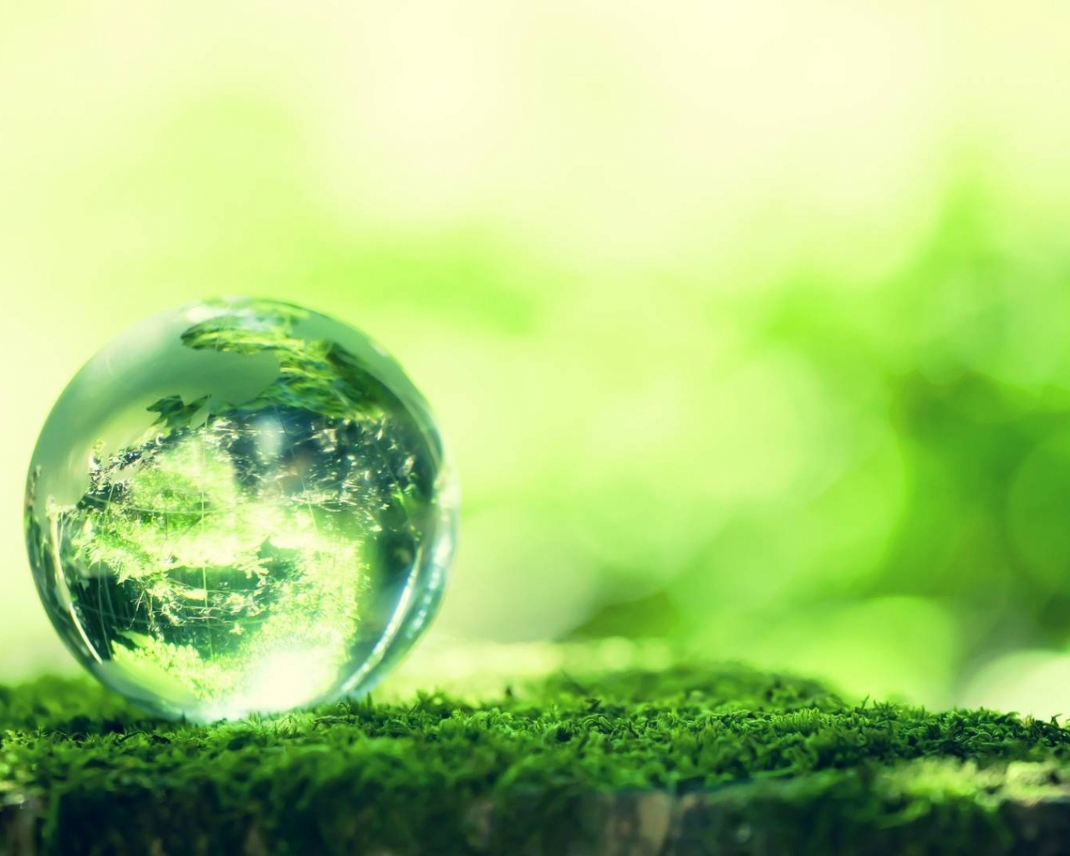
Structure of an Environment
Environment is both physical and biological. It includes both living and non-living components.
Physical Environment- The Physical Environment is classified into three broad categories viz.
Solid
Liquid
Gas.
Biological Environment- The biological of the environment consists
Plants (flora)
Animals (fauna).

Slide 8
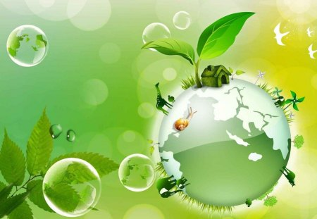
Sustainable Development
Sustainable development:-
The use of resources to satisfy current needs without compromising future availability of resources for generations to come
Sustainability:-
Leaves future generations with a rich and full Earth –
Conserves the Earth’s natural resources
Maintains fully functioning ecological systems of nature

Slide 9
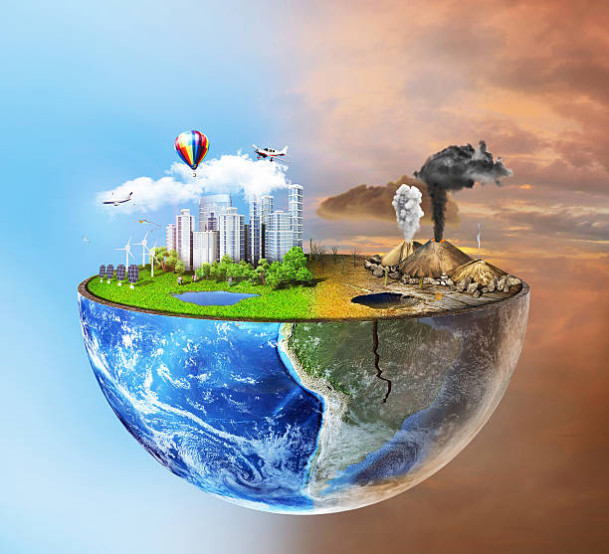
Need for Public Awareness
Some of the challenges are as under:
Growing Population
Poverty
Agricultural Growth
Need to Ground water
Development And Forests
Degradation of Land
Reorientation of Institutions
Reduction of Genetic Diversity

Slide 10

Conclusion
Environmental science helps us understand our relationship with the environment and informs our attempts to solve and prevent problems.
Identifying a problem is the first step in solving it.
Solving environmental problems can move us towards health, longevity, peace and prosperity.
Environmental science can help us find balanced solutions to environmental problems for sustainable development

Slide 11
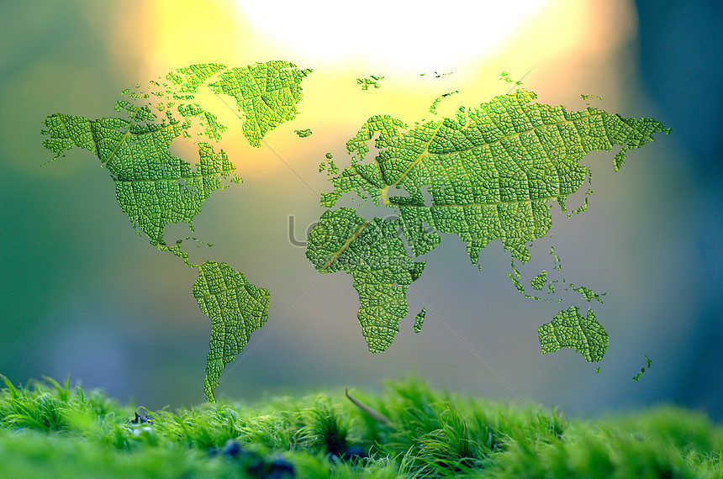
THANK YOU!!

